Slide 1
HCI DESIGN CHALLENGE GROUP #29
Live on Sunshine
ASHUTOSH PANDA – DURGESH NANDAN – MALIK OSENI – ROHAN BHUJBAL – VEDANT PARAB

Slide 2
TABLE OF CONTENTS
01
02
03
04
PHASE 1
PHASE 2
Ideation
Empathize
PHASE 3
PHASE 4
Design
Conclusion
Table of Contents

Slide 3
01
PHASE 1 Problem Statement Brainstorming, Filter and Finalising Ideas,

Slide 4
PROBLEM STATEMENT
Climate change, driven by global warming and increased carbon emissions, poses a major threat. Local actions of millions contribute to displacement, resource competition, and disruption. Individuals, feeling their impact is limited, seek effective ways to address this complex issue.
The "think global, act local" mantra suggests a solution. However, implementing impactful local actions—such as reducing emissions, conserving energy, and promoting recycling—requires innovative approaches. Solutions include optimizing transportation, reducing dependencies on high-emission industries, and fostering self-sufficiency in energy and food.
PROBLEM STATEMENT

Slide 5
PROBLEM STATEMENT CONT.
To empower individuals in mitigating climate change locally, innovative solutions are needed to bridge the gap between global challenges and individual actions.
PROBLEM STATEMENT

Slide 6
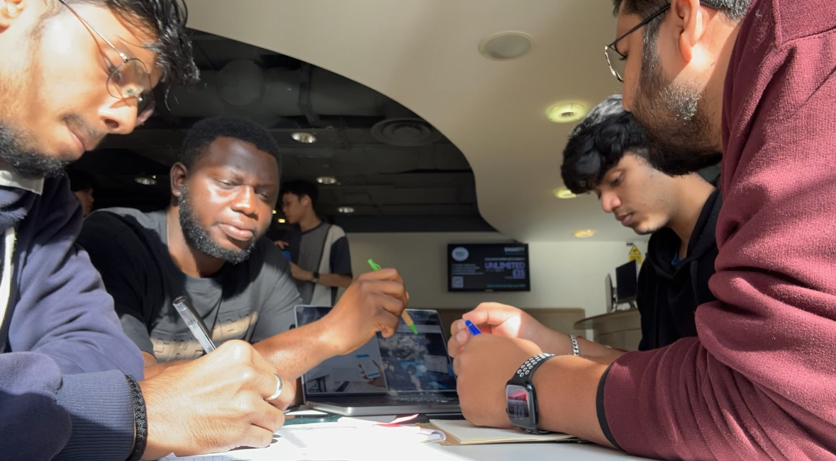

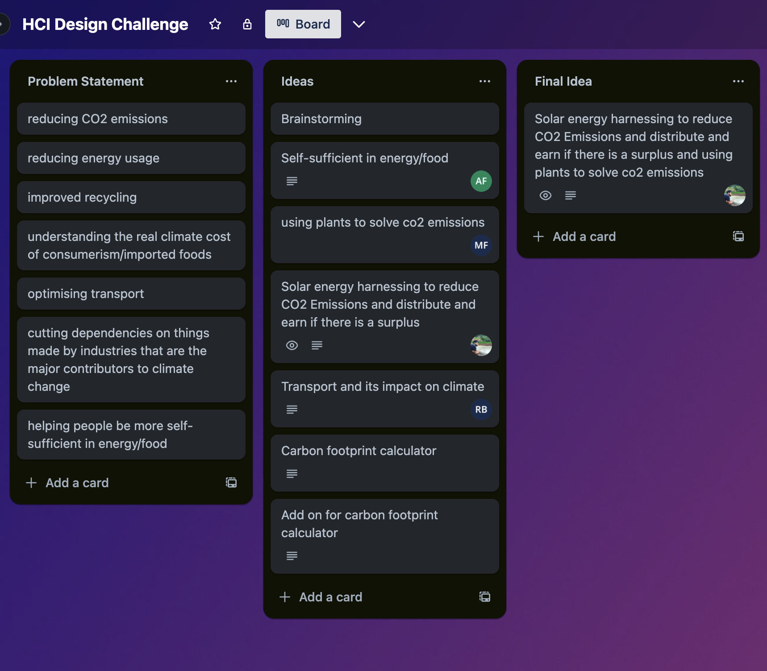
Brainstorming
Since we needed a solution that can help solve the ‘Climate change’ problem. The group started thinking about a solution which could help the cause. As each member of the group produced distinct ideas, we had to define them clearly and pick one which seemed the best idea.
SOLAR ENERGY COMPANY - SOLAR ENERGY COMPANY - SOLAR ENERGY COMPANY

Slide 7
Filtering Ideas
We went through a few brainstorming sessions and everyone in the team produced distinct ideas. This helped us to decide which idea should we go ahead with keeping in mind that it should reflect on the problem statement defined. We also had to investigate the feasibility of the solution and the market demography of the requirement of the product.
Self Sustainable Home
App with guided learning to the kitchen maintenance, gardening, and cooking using less energy.
Sustainable Transport
Find alternative ways to commute using carpooling, bikes, and EV vehicles, with route plan and journey planner
Carbon Footprint Calculator
Calculator that monitors individual contribution to carbon emission to make them aware.
Solar Tracker
Tracks the harnessing, usage, storage, and redistribution
Gardening App
A gamified app which uses VR and AI to promote home gardening and educate users about all aspects of gardening along with rewards for better engagement

Slide 8
Initial Idea
We decided to go ahead with the Solar tracker first as It was promising but the idea was too generic and there were organisations which are providing similar solutions to the customers.
Enphase
Enlighten
But they were not available across most regions are are relatively expensive. Also, the user engagement was less as there were not much of extra features, or gamifications involved.
[1] Enphase : https://enphase.com
[2] Enlighten : https://www.enlightensolar.energy/

Slide 9
Final Idea
This concept has the potential to revolutionize energy sharing and agricultural practices in developing regions. By bridging the gap between urban solar power producers and rural farmers, it can promote sustainable energy consumption, enhance agricultural productivity, and improve the lives of both communities. The gamified approach and IoT integration make it a unique and engaging solution that can contribute to a more sustainable and equitable future. Following are the major USPs of the Idea.
Solar Power Sharing: Urban residents with excess solar power can share their energy with rural farmers through a smart grid infrastructure. Farmers receive affordable electricity, reducing their reliance on expensive generators and promoting sustainable energy consumption.

Slide 10
Final Idea cont.
2. IoT-Powered Gardening: Farmers utilize IoT-enabled gardening systems to monitor and optimize their crop growth. Sensors collect data on soil moisture, nutrient levels, and other factors, allowing farmers to make informed decisions about irrigation, fertilization, and pest control.
3. Gamified Rewards: Both urban solar power producers and rural farmers earn rewards points for their participation. Urban residents earn points for sharing their excess solar power, while farmers earn points for adopting IoT-based gardening practices and achieving specific crop yields.
4. Reward Redemption: Accumulated reward points can be redeemed for various benefits, including discounts on electricity bills, groceries, and farm supplies. This encourages both urban and rural participants to engage actively in the projects ecosystem.

Slide 11
02
PHASE 2 Background Research, Understanding Users and Personas

Slide 12
Questionnaire Design
To further streamline our requirements by understanding user requirements and their preferences, we designed a set of questions for survey to be shared across the people of India and Nigeria using Social Platforms like WhatsApp, Instagram, Facebook. The survey had sections focusing on get the information about Demography, Budget, Interest in adopting renewable sources.
After evaluating the form among ourselves we started sharing it across to get the responses. The next slides discuss about some of the questions that acted as major data points to refine the features about the application and we also get to know about the unnecessary questions about the survey. Survey Link : Form Link

Slide 13
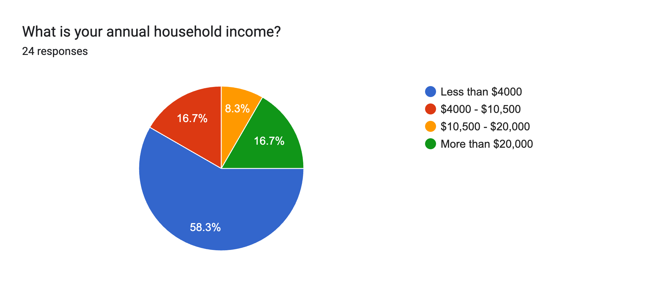
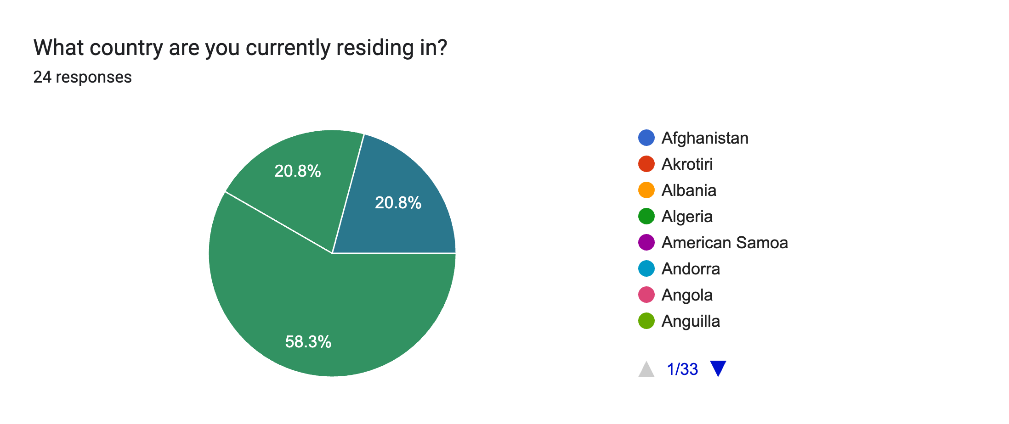
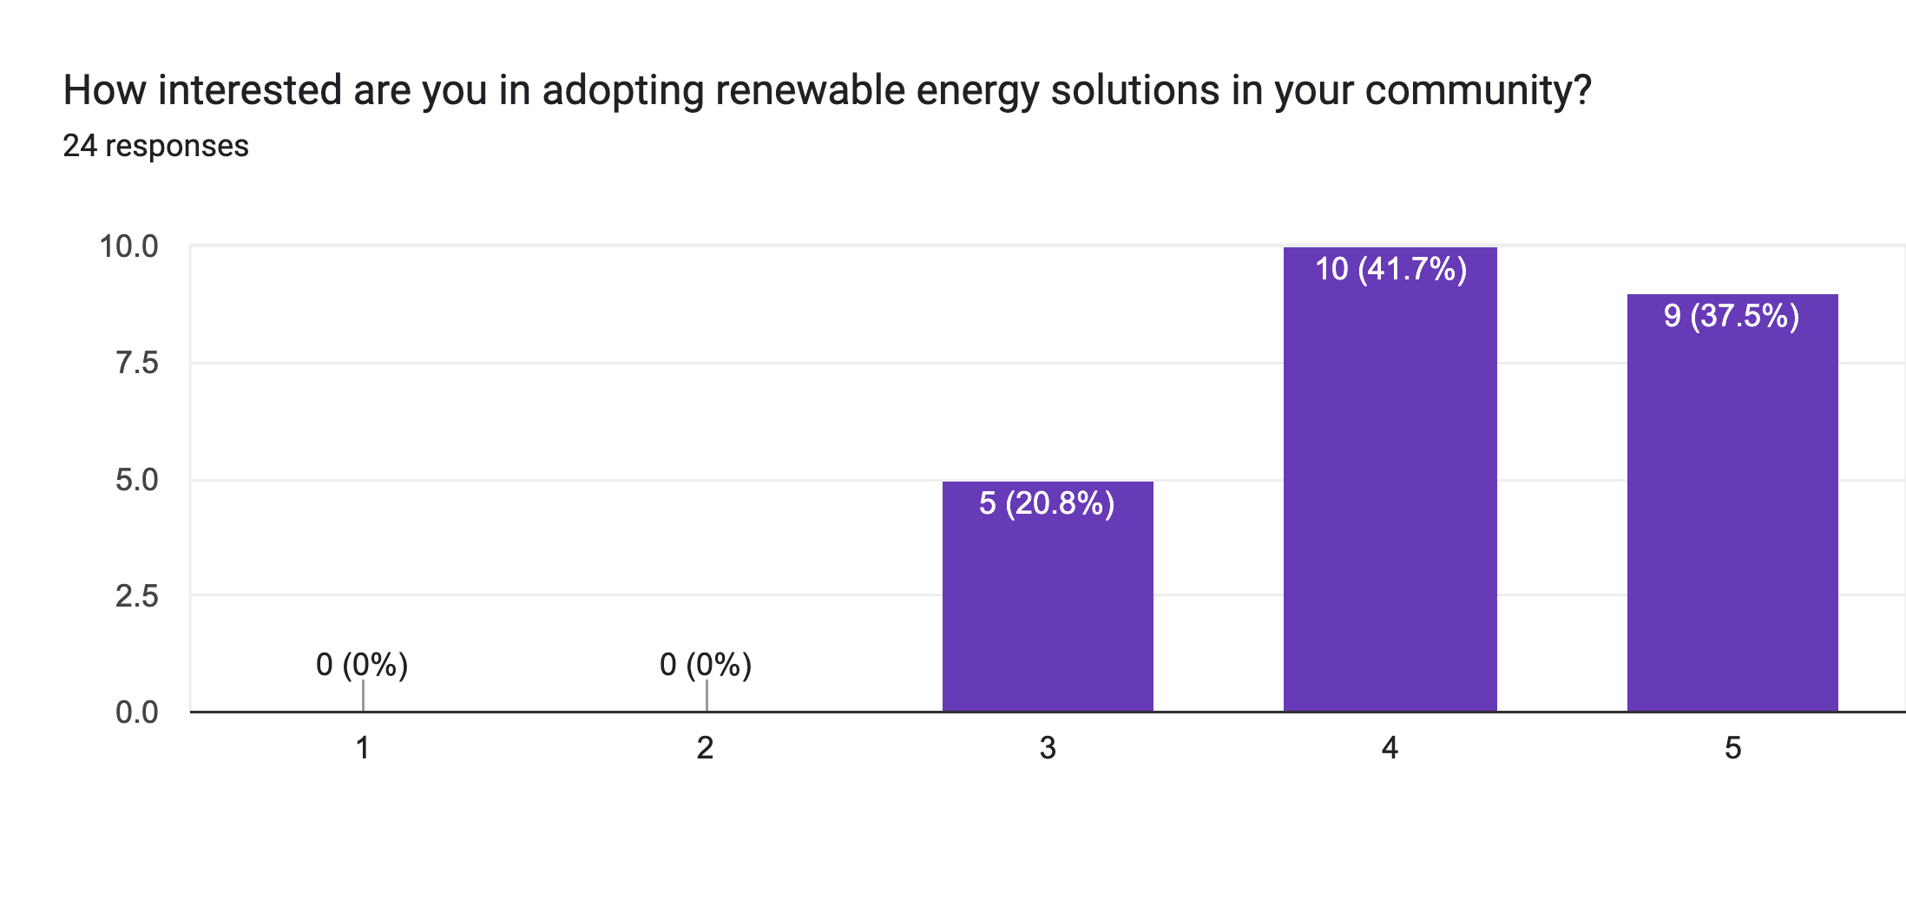
Questionnaire Results
The initial chart depicting annual household income reveals that a significant portion of survey participants earns less than $4000 annually, a sum deemed adequate for metropolitan living in India and Nigeria. The escalating costs of conventional electricity sources appear to be consuming a considerable portion of their income. This circumstance might be a driving factor behind their inclination towards the adoption of solar power, whether for sale, purchase, or a combination of both.
In the second graph, the survey's demographic breakdown indicates that 58.3% of respondents are from India, while 20.8% each are from Nigeria and the United Kingdom. The UK respondents, primarily students, pose challenges in determining their origin.
The third graph highlights a prevalent interest among surveyed individuals in embracing renewable energy solutions for their communities, with a majority expressing a strong inclination, as evident in the most likely category.

Slide 14
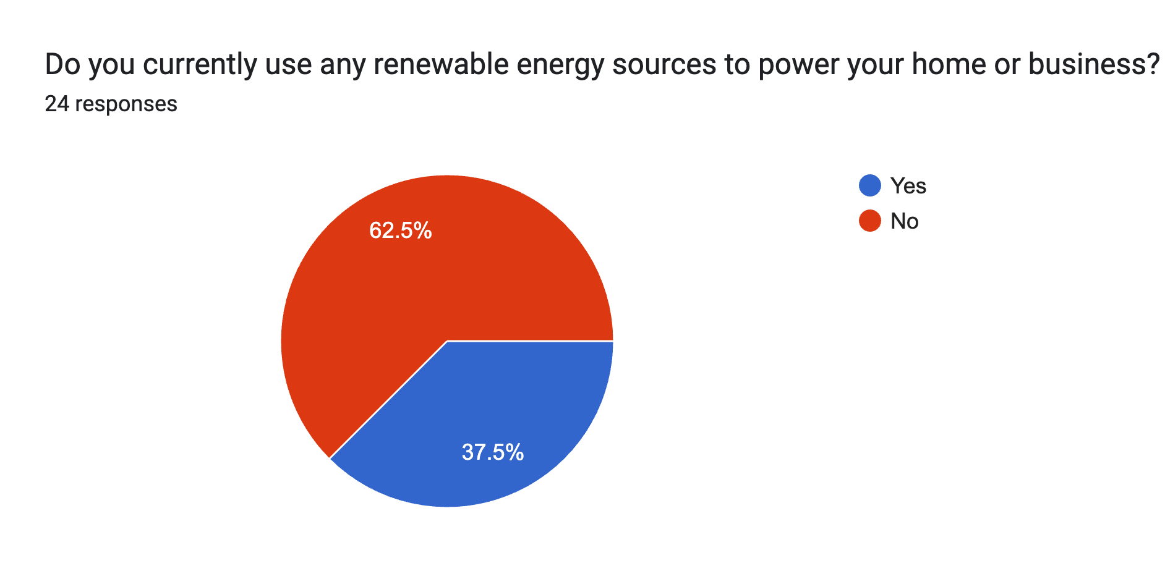
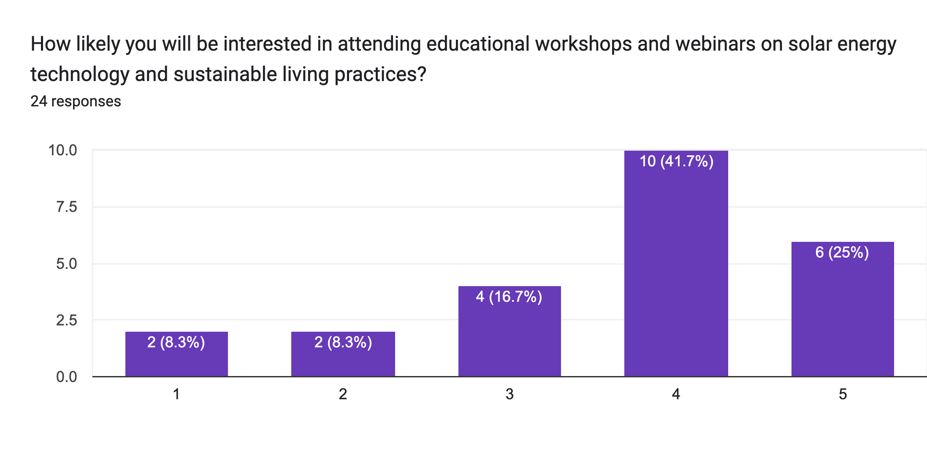
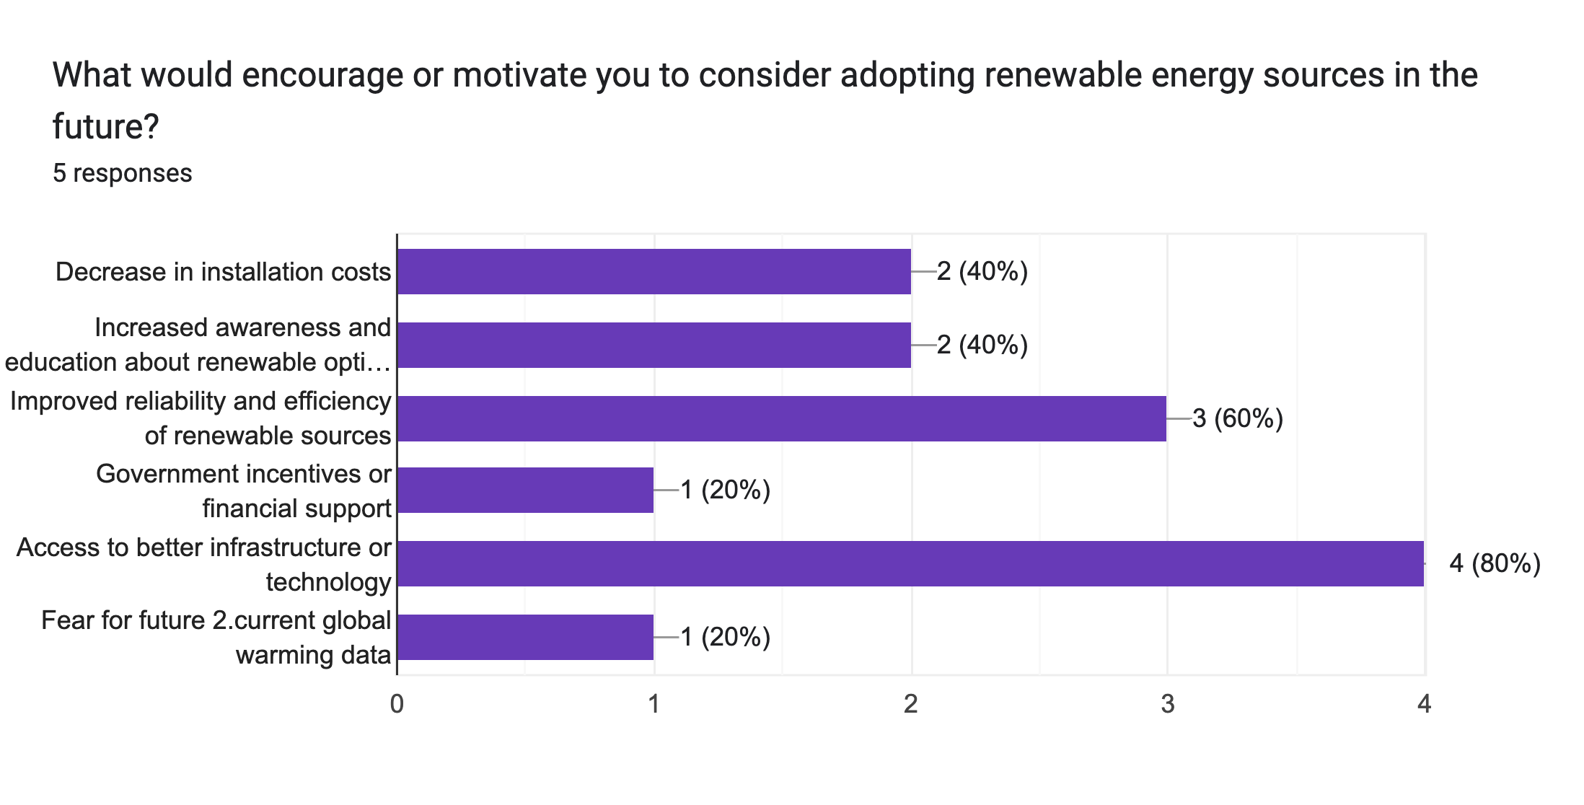
Questionnaire Results
The first graph shows that most of the participants don’t use renewable sources in any form in their home and business setting. This huge gap makes our application acceptable and with proper awareness campaigns this can be achieved.
The second graph shows that the people are interested in attending the workshops and campaigns that could help them gain in depth knowledge about employing solar energy solutions In their daily sustainable living practice and the technology behind it.
People are more encouraged or motivated with the factors like access to better infrastructure or technology, Improved reliability and efficiency of renewable sources, installation costs, increased awareness. Participants are least concerned about government incentives.

Slide 15
Questionnaire Results
The first graph shows that most of the participants don’t use renewable sources in any form in their home and business setting. This huge gap makes our application acceptable and with proper awareness campaigns this can be achieved.
The second graph shows that the people are interested in attending the workshops and campaigns that could help them gain in depth knowledge about employing solar energy solutions In their daily sustainable living practice and the technology behind it.
People are more encouraged or motivated with the factors like access to better infrastructure or technology, Improved reliability and efficiency of renewable sources, installation costs, increased awareness. Participants are least concerned about government incentives.

Slide 16
03
PHASE 3 Scenarios, UML, Sketches, Wireframes, Prototypes,

Slide 17
04
PHASE 4 Mockups, Poster, Team Work and Group Management

Slide 18
INTRODUCTION
SOLAR ENERGY COMPANY - SOLAR ENERGY COMPANY - SOLAR ENERGY COMPANY
Mercury is the closest planet to the Sun and the smallest one in the Solar System—it’s only a bit larger than the Moon. The planet’s name has nothing to do with the liquid metal, since Mercury was named after the Roman messenger god
SOLAR ENERGY COMPANY - SOLAR ENERGY COMPANY - SOLAR ENERGY COMPANY

Slide 19
OUR COMPANY
Mercury is the closest planet to the Sun and the smallest one in the Solar System—it’s only a bit larger than the Moon. The planet’s name has nothing to do with the liquid metal
OUR COMPANY - OUR COMPANY - OUR COMPANY - OUR COMPANY - OUR COMPANY - OUR COMPANY

Slide 20

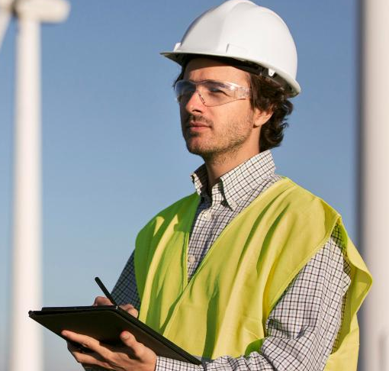

OUR TEAM
JENNA DOE
TOMMY LEAN
SUSAN BONES
You can replace the image on the screen with your own
You can replace the image on the screen with your own
You can replace the image on the screen with your own
OUR TEAM - OUR TEAM - OUR TEAM - OUR TEAM - OUR TEAM - OUR TEAM

Slide 21
CONTENTS OF THIS TEMPLATE
This is a slide structure based on a pitch deck presentation
You can delete this slide when you’re done editing the presentation
FONTS | To view this template correctly in PowerPoint, download and install the fonts we used
USED AND ALTERNATIVE RESOURCES | An assortment of graphic resources that are suitable for use in this presentation
THANKS SLIDE | You must keep it so that proper credits for our design are given
COLORS | All the colors used in this presentation
INFOGRAPHIC RESOURCES | These can be used in the template, and their size and color can be edited
CUSTOMIZABLE ICONS | They are sorted by theme so you can use them in all kinds of presentations
For more info: SLIDESGO | SLIDESGO SCHOOL | FAQS
You can visit our sister projects: FREEPIK | FLATICON | STORYSET | WEPIK | VIDFY
CONTENTS OF THIS TEMPLATE - CONTENTS OF THIS TEMPLATE - CONTENTS OF THIS TEMPLATE

Slide 22
THEM
US
Mercury is the closest planet to the Sun and the smallest one in the Solar System—it’s only a bit larger than the Moon
Venus has a beautiful name and is the second planet from the Sun. It’s hot and has a poisonous atmosphere
SOLAR ENERGY COMPANY - SOLAR ENERGY COMPANY - SOLAR ENERGY COMPANY

Slide 23
320,000
SOLAR ENERGY COMPANY - SOLAR ENERGY COMPANY
Big numbers catch your audience’s attention
SOLAR ENERGY COMPANY - SOLAR ENERGY COMPANY

Slide 24
SOLUTION
Venus has a beautiful name and is the second planet from the Sun. It’s terribly hot—even hotter than Mercury—and its atmosphere is extremely poisonous
SOLUTION - SOLUTION - SOLUTION - SOLUTION - SOLUTION - SOLUTION

Slide 25
SWOT ANALYSIS
STRENGTHS
WEAKNESSES
OPPORTUNITIES
THREATS
S
Mercury is the smallest planet of them all
W
Venus has a beautiful name, but also high temperatures
O
Earth is the beautiful planet where we all live on
T
Despite being red, Mars is actually a cold place
SWOT ANALYSIS - SWOT ANALYSIS - SWOT ANALYSIS
SWOT ANALYSIS - SWOT ANALYSIS - SWOT ANALYSIS - SWOT ANALYSIS

Slide 26
PRODUCT OVERVIEW
MERCURY
VENUS
EARTH
MARS
SATURN
Mercury is the smallest planet of them all
Venus is the second planet from the Sun
Earth is the only planet known to harbor life
Despite being red, Mars is actually a cold place
Saturn is not the only planet with rings
PRODUCT OVERVIEW - PRODUCT OVERVIEW - PRODUCT OVERVIEW

Slide 27
OUR PLANS
BASIC
PRO
PREMIUM
$10,000
$19,000
$26,000
Mercury is the closest planet to the Sun and the smallest of them all
Venus has a beautiful name and is the second planet from the Sun
Despite being red, Mars is actually a cold place. It's full of iron oxide dust
OUR PLANS - OUR PLANS - OUR PLANS - OUR PLANS - OUR PLANS - OUR PLANS

Slide 28
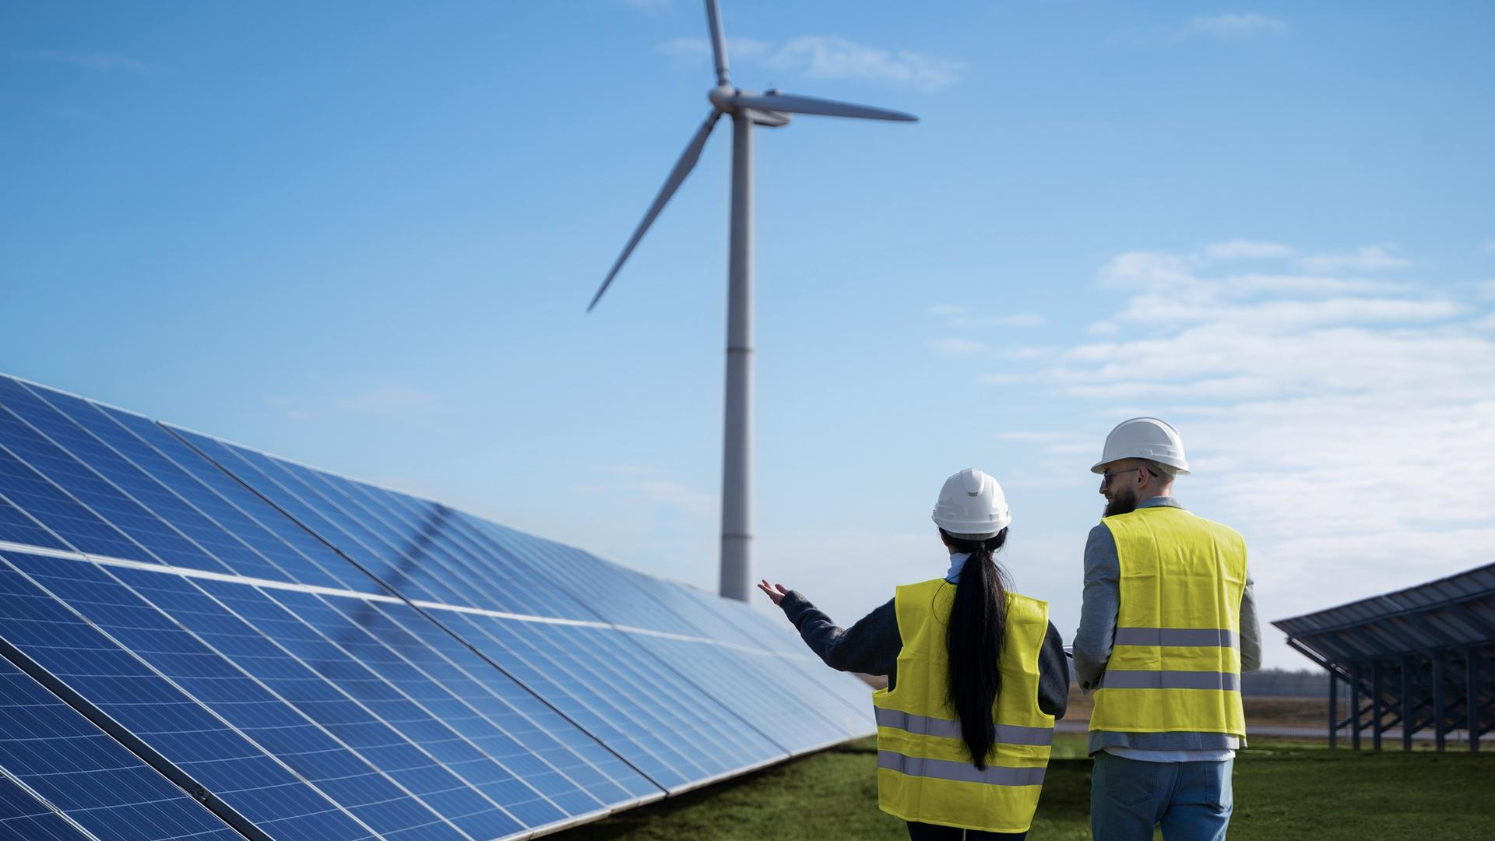
A PICTURE IS WORTH A THOUSAND WORDS
SOLAR ENERGY COMPANY - SOLAR ENERGY COMPANY - SOLAR ENERGY COMPANY
SOLAR ENERGY COMPANY - SOLAR ENERGY COMPANY - SOLAR ENERGY COMPANY

Slide 29
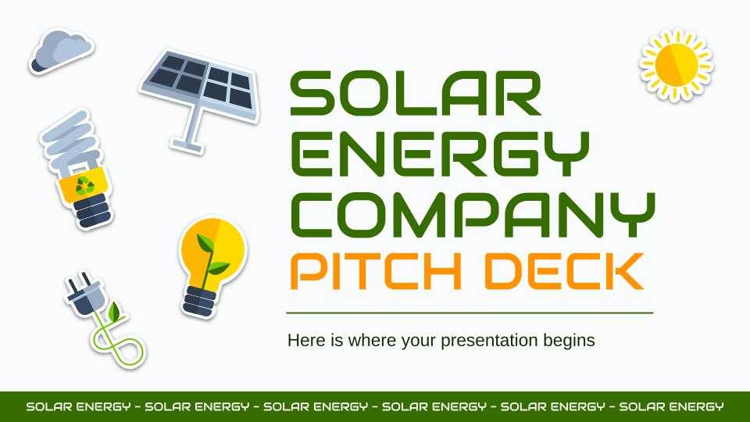
PRODUCT DEMO
You can replace the image on the screen with your own work. Just right-click on it and select “Replace image”
SOLAR ENERGY COMPANY - SOLAR ENERGY COMPANY

Slide 30
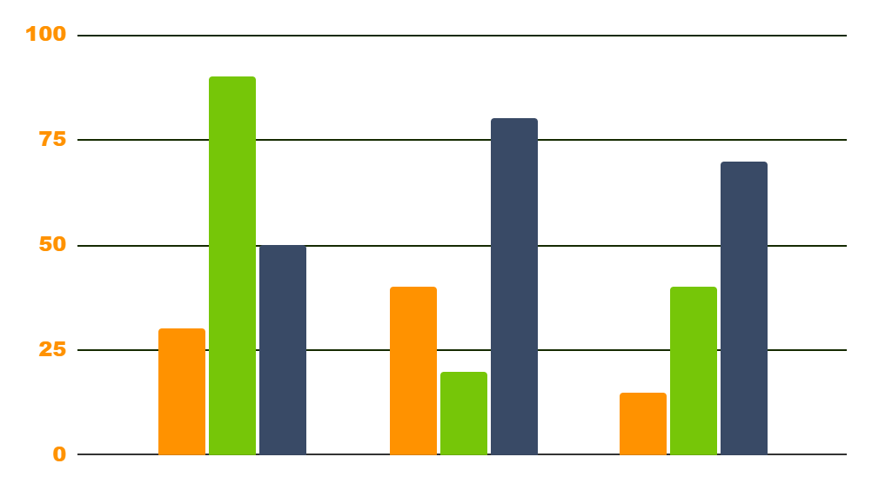
TRACTION
$140,000
12,000
$150
150,000,00$
JUPITER
VENUS
MARS
Gross revenues in 2021
Gross revenue in 2020
Registered businesses
Home energy savings
Follow the link in the graph to modify its data and then paste the new one here. For more info, click here
TRACTION - TRACTION - TRACTION - TRACTION - TRACTION - TRACTION - TRACTION

Slide 31
AWESOME WORDS
SOLAR ENERGY COMPANY - SOLAR ENERGY COMPANY
SOLAR ENERGY COMPANY - SOLAR ENERGY COMPANY

Slide 32
CASE STUDY
CHALLENGE
BUDGET
RESULTS
SOLUTIONS
Despite being red, Mars is actually a cold place full of iron oxide dust
Jupiter is a gas giant and the biggest planet in the entire Solar System
Venus has a beautiful name and is the second planet from the Sun
Saturn is a gas giant, composed mostly of hydrogen and helium
CASE STUDY - CASE STUDY - CASE STUDY - CASE STUDY - CASE STUDY

Slide 33

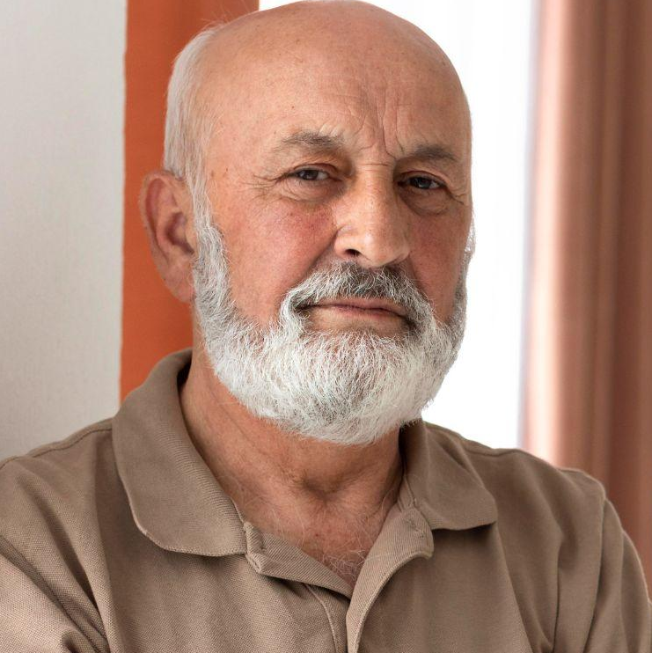
REVIEWS
NICOLE WILLS
RON SMITH
“Mercury is the closest planet to the Sun and the smallest one in the Solar System”
“Jupiter is the biggest planet in the Solar System and the fourth-brightest object in the sky”
REVIEWS - REVIEWS - REVIEWS - REVIEWS - REVIEWS - REVIEWS - REVIEWS

Slide 34
LATEST AWARDS
MERCURY
JUPITER
NEPTUNE
Mercury is the smallest planet of them all
Jupiter is the biggest planet of them all
Neptune is the farthest planet from the Sun
AWARDS - AWARDS - AWARDS - AWARDS - AWARDS - AWARDS - AWARDS - AWARDS

Slide 35
—SOMEONE FAMOUS
SOLAR ENERGY COMPANY - SOLAR ENERGY COMPANY
“This is a quote, words full of wisdom that someone important said and can make the reader get inspired.”
SOLAR ENERGY COMPANY - SOLAR ENERGY COMPANY

Slide 36
MARKET SIZE
60%
40%
MERCURY
VENUS
Mercury is the closest planet to the Sun
Venus is the second planet from the Sun
MARKET SIZE - MARKET SIZE - MARKET SIZE - MARKET SIZE - MARKET SIZE - MARKET SIZE

Slide 37
TARGET
$200
AGE
SPEND PER CUSTOMER
10%
50%
40%
Venus has a beautiful name, but also high temperatures
23 - 30
31 - 45
46+
GENDER
INTERESTS
Man
30%
Devices
Home
Woman
50%
Others
20%
Savings
Transportation
TARGET - TARGET - TARGET - TARGET - TARGET - TARGET - TARGET - TARGET - TARGET

Slide 38
OUR COMPETITORS
 | COMPETITOR A | COMPETITOR B | COMPETITOR C
DESCRIPTION | Mercury is the smallest planet of them all | Venus is terribly hot, even hotter than Mercury | Phobos and Deimos are both Mars’s moons
CHARACTERISTIC | Despite being red, Mars is actually a cold place | Jupiter is a gas giant planet in the Solar System | Saturn is a gas giant and has several rings
PRODUCT | Neptune is the farthest planet from the Sun | Earth is where we all live on and a blue planet | The Sun is the star at the center of the Solar System
COMPETITORS - COMPETITORS - COMPETITORS - COMPETITORS - COMPETITORS

Slide 39
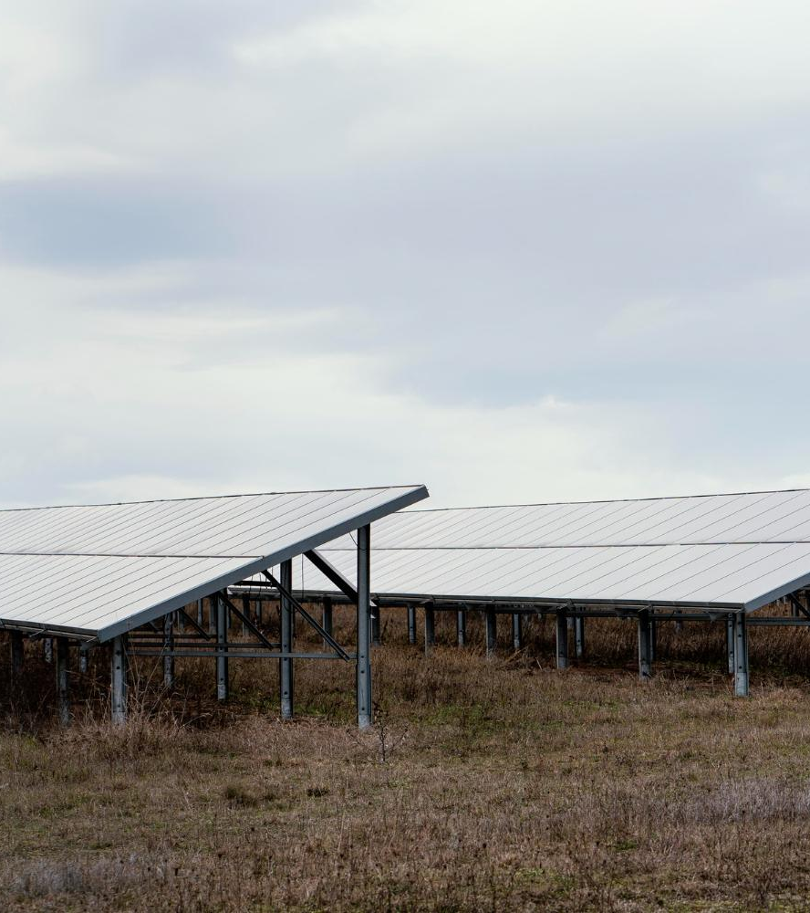
A PICTURE ALWAYS REINFORCES THE CONCEPT
SOLAR ENERGY COMPANY - SOLAR ENERGY COMPANY - SOLAR ENERGY COMPANY
Images reveal large amounts of data, so remember: use an image instead of a long text. Your audience will appreciate it
SOLAR ENERGY COMPANY - SOLAR ENERGY COMPANY - SOLAR ENERGY COMPANY

Slide 40
BUSINESS MODEL
SATURN
EARTH
JUPITER
VENUS
MARS
MERCURY
Saturn is not the only planet with rings
Earth is the only planet known to harbor life
Jupiter is the biggest planet of them all
Venus is the second planet from the Sun
Despite being red, Mars is actually a cold place
Mercury is the smallest planet of them all
BUSINESS MODEL - BUSINESS MODEL - BUSINESS - BUSINESS - BUSINESS

Slide 41
TIMING
WEEK 01
WEEK 02
WEEK 03
WEEK 04
MARS
VENUS
SATURN
JUPITER
Despite being red, Mars is cold
Venus has a beautiful name
Saturn is a gas giant with rings
Jupiter is a very big planet
TIMING - TIMING - TIMING - TIMING - TIMING - TIMING - TIMING - TIMING - TIMING - TIMING

Slide 42
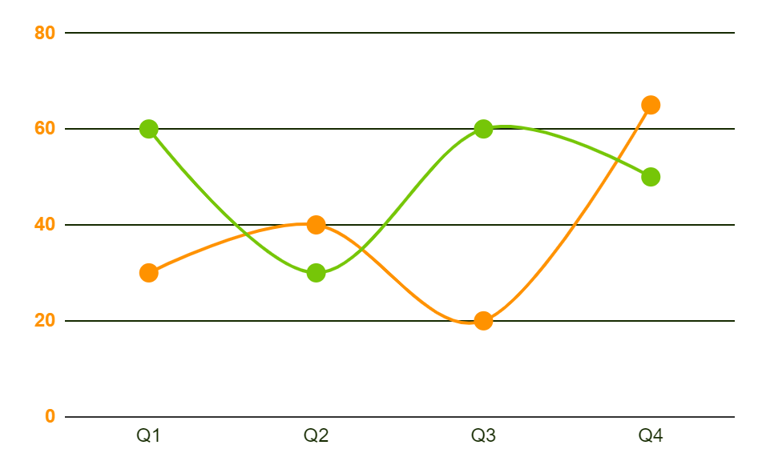
PREDICTED GROWTH
80%
$60M
Increased income
Expected income
65%
2,000
More employees
Total employees
Follow the link in the graph to modify its data and then paste the new one here. For more info, click here
PREDICTED GROWTH - PREDICTED GROWTH - PREDICTED GROWTH - PREDICTED GROWTH

Slide 43
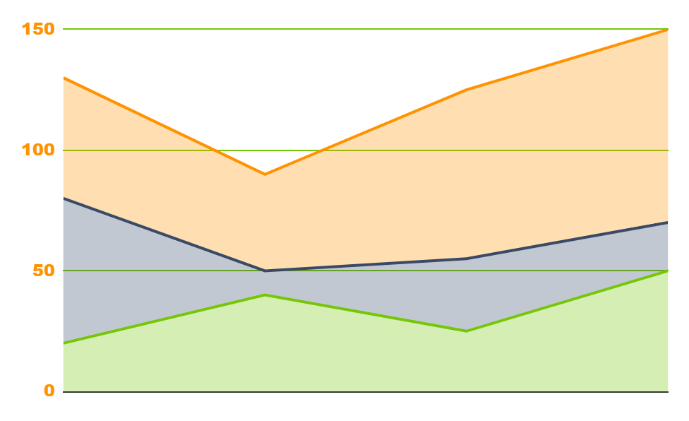
INVESTMENT
VENUS
20%
Venus is the second planet from the Sun
MARS
30%
Mars is full of iron oxide dust
EARTH
50%
Earth is the third planet from the Sun
2020
2021
2022
Follow the link in the graph to modify its data and then paste the new one here. For more info, click here
INVESTMENT - INVESTMENT - INVESTMENT - INVESTMENT - INVESTMENT - INVESTMENT

Slide 44
9h 55m 23s
333,000
386,000 km
SOLAR ENERGY COMPANY - SOLAR ENERGY COMPANY - SOLAR ENERGY COMPANY
Jupiter's rotation period
The Sun’s mass compared to Earth’s
Distance between Earth and the Moon
SOLAR ENERGY COMPANY - SOLAR ENERGY COMPANY - SOLAR ENERGY COMPANY

Slide 45
THANKS!
THANKS! - THANKS! - THANKS! - THANKS!
Do you have any questions?
addyouremail@freepik.com
+91 620 421 838
yourwebsite.com
Please keep this slide for attribution
THANKS! - THANKS! - THANKS! - THANKS!

Slide 46
ICON PACK
SOLAR ENERGY COMPANY - SOLAR ENERGY COMPANY

Slide 47
ALTERNATIVE RESOURCES
Here’s an assortment of alternative resources whose style fits the one of this template:
VECTORS
Eco energy flat icons
Isolated eco icon set
ALTERNATIVE RESOURCES - ALTERNATIVE RESOURCES - ALTERNATIVE RESOURCES

Slide 48
RESOURCES
Did you like the resources on this template? Get them for free at our other websites:
VECTORS
Ecology icons set
Eco energy flat icons
ICONS
Icon Pack: Ecology Test Task | Lineal color
PHOTOS
Portrait of a beautiful woman engineer
Medium shot smiley engineer holding tablet
Wind farms fields
Medium shot engineers discussing about solar panels
Field with lots of solar panels and copy space
Medium shot old man posing
Smiley woman looking at the phone with copy space
RESOURCES - RESOURCES - RESOURCES - RESOURCES - RESOURCES - RESOURCES

